Slide 1
Patients Over Profiteering
Kalvin Pugh, Director of 340B State Policy, Community Access National Network (CANN)

Slide 2
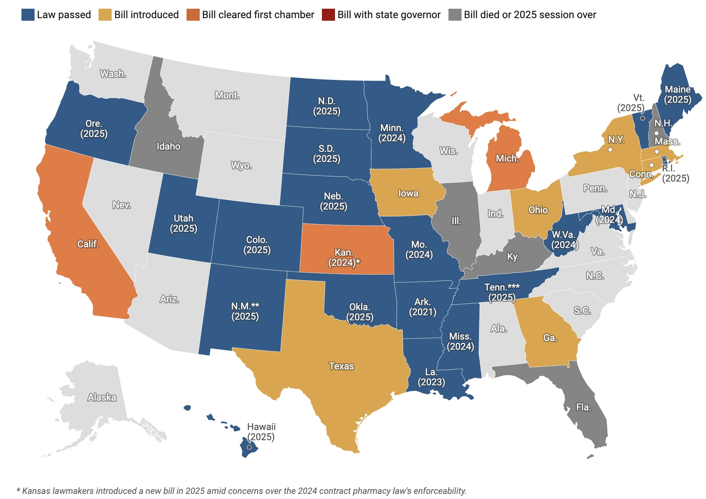
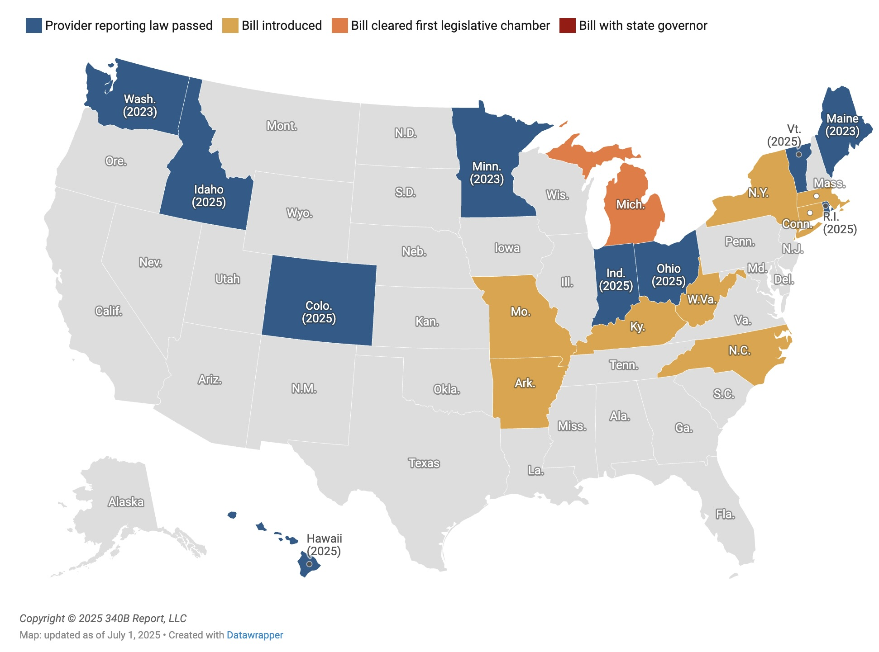
State Legislation

Slide 3



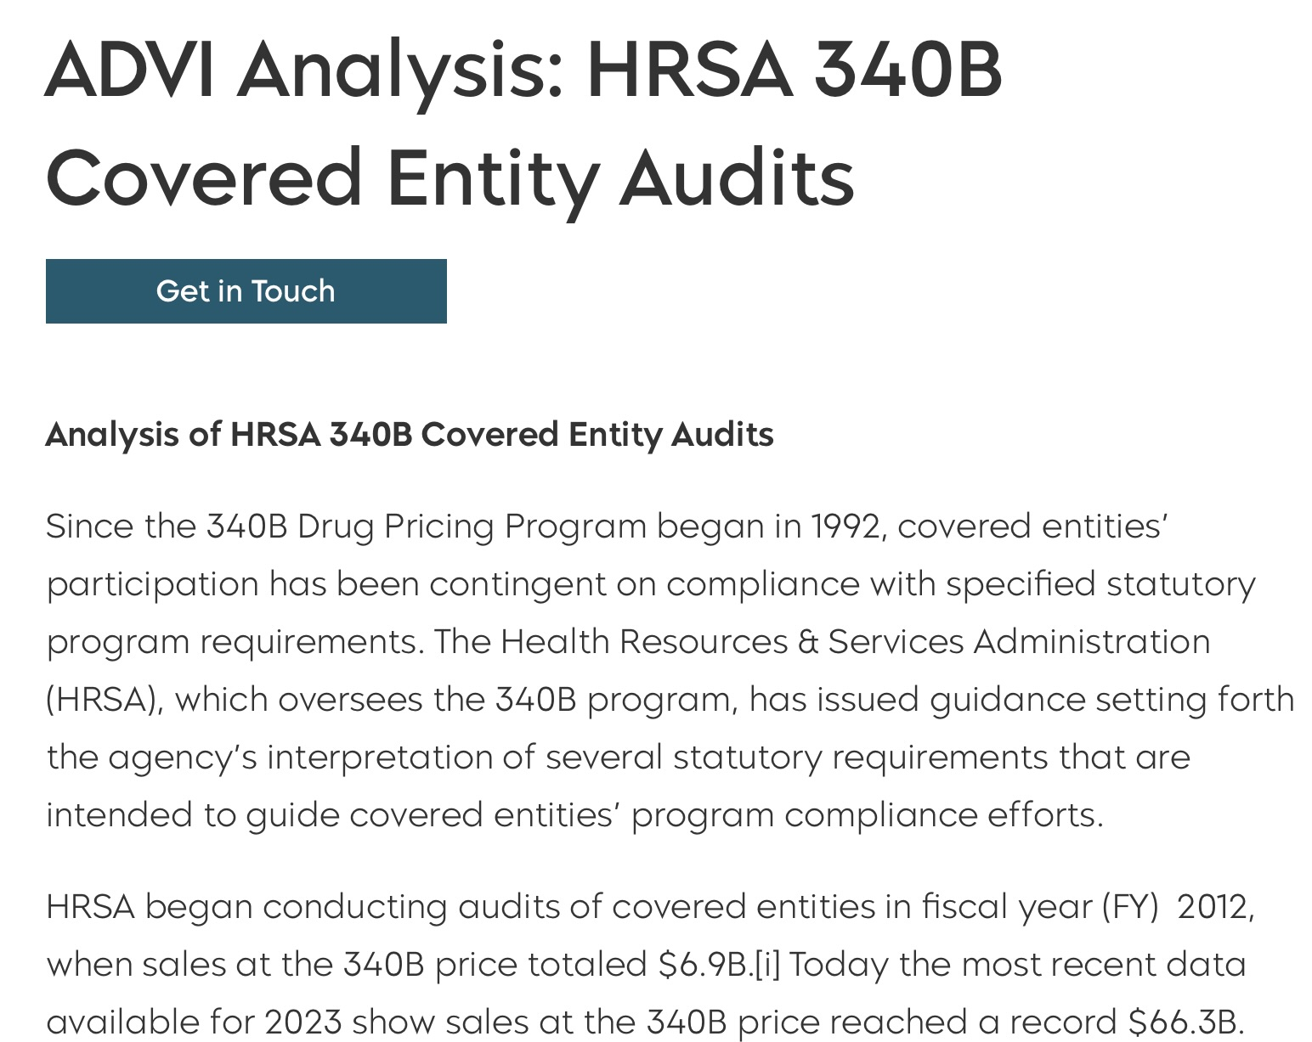
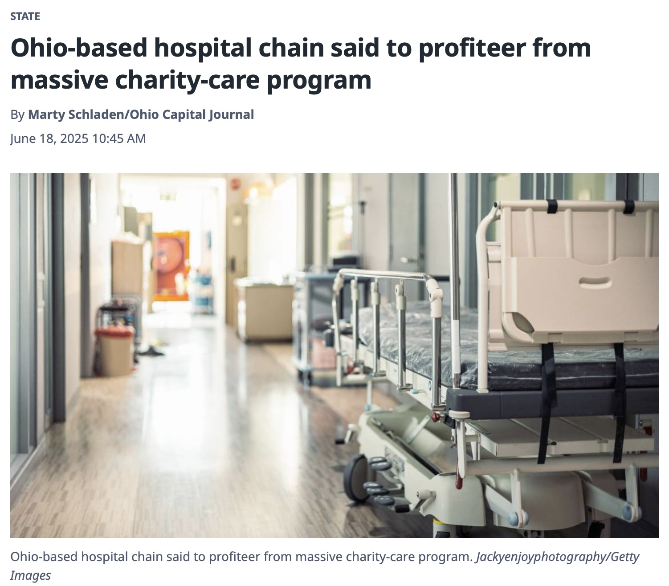
Profiteering
From the 340B Cookie Jar
Large Hospital Systems
Large For-Profit Chain Pharmacies
Pharmacy Benefit Managers
Private Equity Companies
Third-Party Administrators

Slide 4

Transparency
As of 2024 only 3 states required reporting
For-profit contract pharmacies and TPAs benefit from the 340B program, absorbing at least 16% of covered entities’ profits through per-prescription fees and shared savings
Hospitals report using 340B revenue on “capital improvement projects” and “community benefit programs,” but do not account for what specific expenses 340B revenue goes towards

Slide 5
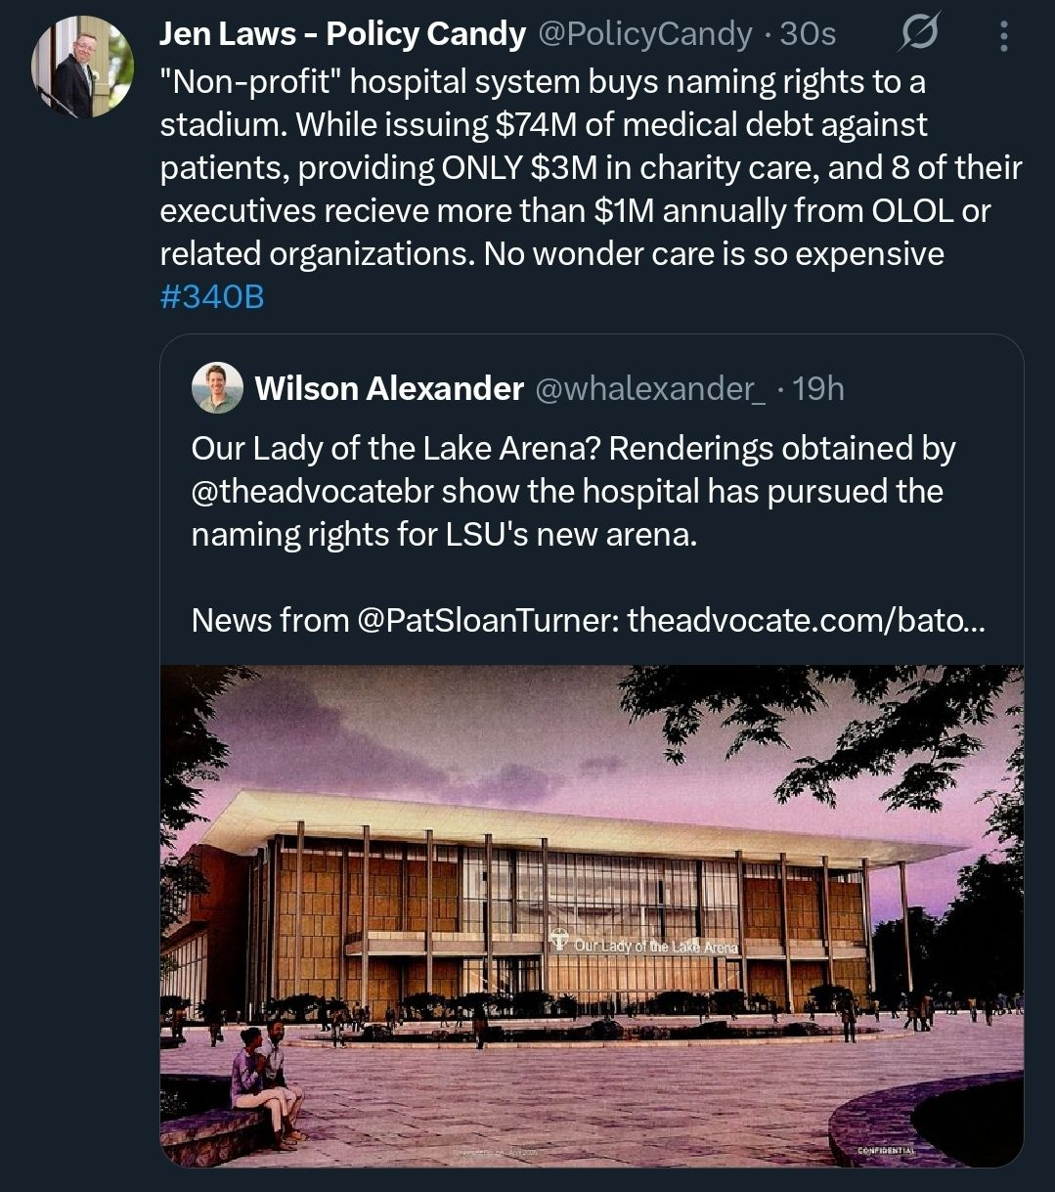
Consequences
Rising Medical Costs
Crippling Medical Debt
Closure of Community Pharmacies
Consolidation of Healthcare Facilities
Loss of Access to Community Healthcare

Slide 6
“This investigation underscores that there are transparency and oversight concerns that prevent 340B discounts from translating to better access or lower costs for patients. Congress needs to act to bring much-needed reform to the 340B Program,”
Senator Bill Cassidy Chair M.D.
Chair of the Senate Health, Education, Labor, and Pensions (HELP) Committee

Slide 7
Closing
kalvin@tiicann.org

